Slide 1
CN Lab - 3

Slide 2
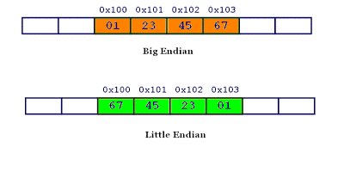
Little and Big Endian
Little and big endian are two ways of storing multibyte data-types ( int, float, etc).
In little endian machines, last byte of binary representation of the multibyte data-type is stored first.
On the other hand, in big endian machines, first byte of binary representation of the multibyte data-type is stored first.
Suppose integer is stored as 4 bytes then a variable x with value 0x01234567 will be stored as following.

Slide 3
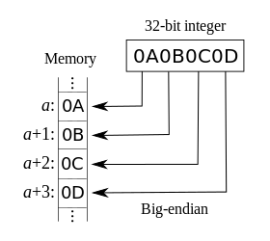
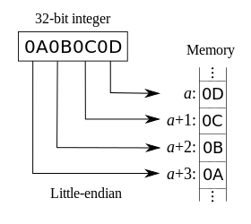
For Big Endian Representations, the Most Significant Byte (MSB) is stored at lower addresses.
For Little Endians, it is the opposite, the MSB is stored at higher addresses.

Slide 4
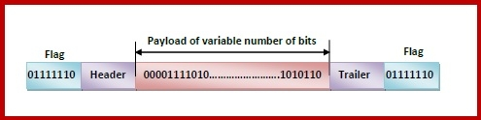
Bit Stuffing
Data link layer is responsible for something called Framing, which is the division of stream of bits into manageable units (called frames).
Frames could be of fixed size or variable size.
In variable-size framing, we need a way to define the end of the frame and the beginning of the next frame.
Bit stuffing is the process of inserting noninformation bits into data to break up bit patterns to affect the synchronous transmission of information.

Slide 5
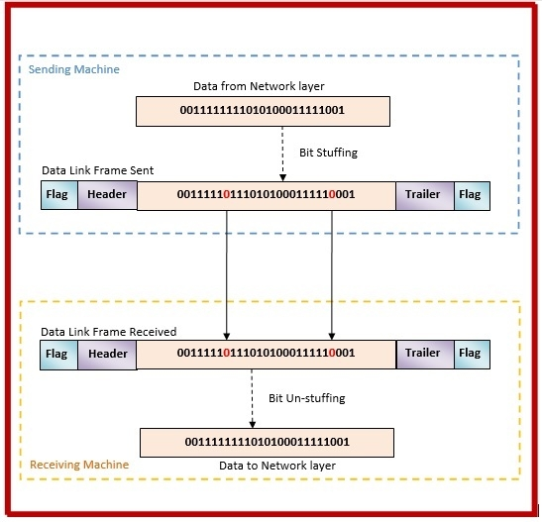
Bit Stuffing Mechanism

Slide 6
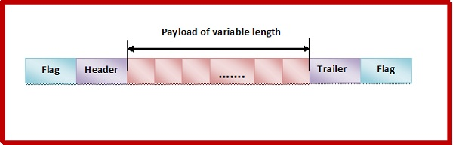
Byte Stuffing
A byte (usually escape character(ESC)), which has a predefined bit pattern is added to the data section of the frame when there is a character with the same pattern as the flag.
Whenever the receiver encounters the ESC character, it removes from the data section and treats the next character as data, not a flag.
But the problem arises when the text contains one or more escape characters followed by a flag.
To solve this problem, the escape characters that are part of the text are marked by another escape character i.e., if the escape character is part of the text, an extra one is added to show that the second one is part of the text.

Slide 7
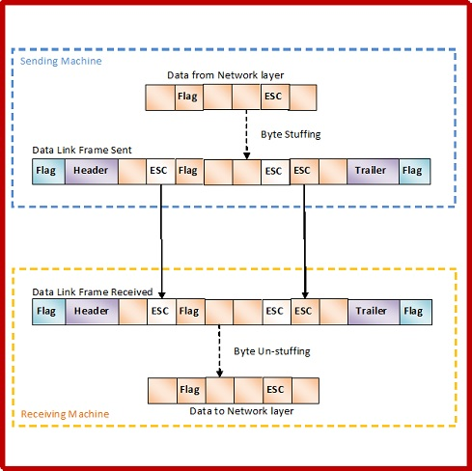
Byte Stuffing Mechanism

Slide 8
WAP to display the memory arrangement on your computer( the memory address and content of the value).
WAP to demonstrate the bit stuffing concept.
WAP to demonstrate byte stuffing concept.

